Slide 1
A TOUR OF APP DEVELOPMENT
Why It Takes So Long
A look under the surface of app development.
Notes:
Welcome them; one line on who you are and why you'd know. Set the promise: by the end, when someone says a small change takes a month, they'll understand why and know how to get better answers from engineers. Keep it warm — this is a tour, not a defense.

Slide 2
THE MOMENT
can you just…
"Can you just add a button?"
You say two weeks. The room goes quiet. This gap is the whole talk.
Add item
Notes:
Tell the scene everyone has lived: someone asks for a small change, you say two weeks, the room goes quiet. Name the feeling honestly — it sounds like padding or slowness. Promise the real answer is more interesting. The throughline: the honest answer to 'how long will this take' is almost always 'it depends,' and that isn't an excuse — it's the nature of the work.

Slide 3
The screen · 10%
WATERLINE
PART ONE · WHAT YOU CAN'T SEE
The screen is about 10% of the app.
Storage
Business rules
Permissions
Error handling
Logging
Testing
Everything that makes the screen trustworthy sits below the waterline.
Notes:
The part people point at — the screen — is the smallest part. Walk them below the waterline: behind one button sits storage, rules about what's allowed, checks on who can do it, handling for failure, a record of what happened. Land the line: visible simplicity is usually the reward for invisible complexity, not the absence of it.

Slide 4
PART ONE · WHAT YOU CAN'T SEE
Requirements are discovered, not handed over.
What are the password rules?
What if they forget it?
Lock the account after failed tries?
THE WISH
"Let users log in."
What if two people share an email?
Signed in on two devices?
What if the account is deleted?
Notes:
'Let users log in' sounds finished. It isn't. Walk the fan-out live: password rules? forgot password? lock after failed tries, for how long? two people sharing an email? Every answer opens a new question. The thinking that turns a vague wish into something precise enough to build is real work — even on days nothing visible ships. When an engineer is 'just asking questions,' that IS the work.

Slide 5
PART ONE · WHAT YOU CAN'T SEE
The demo always works.
Start
Done
The demo.
Notes:
Every demo works, because a demo is the happy path — the one route where everything goes right. The user types what you expected, the network is fine, the data is clean. This is the version people picture when they estimate in their heads. Pause here; the next slide is the turn.

Slide 6
PART ONE · WHAT YOU CAN'T SEE
"It works" is maybe 20% of the effort. "It works when everything goes wrong" is the rest.
Network drops mid-save
Two people, one record
10,000 rows pasted
A name with emoji
Notes:
Now reality arrives. The connection dies halfway through saving. Someone pastes ten thousand rows into a box built for ten. Two people edit the same record at the same second. A name has emoji, or reads right to left, and the layout breaks. None of this is edge-case trivia — this is where most of the surprising time lives. The version that works when the world misbehaves is the real product, and it's most of the job.

Slide 7
PART TWO · THE THREE THAT EAT THE CALENDAR
Data
Security
Policy
Three reasons things take longer that nobody puts in the meeting.
Notes:
Transition. The next three are the heavyweights, and they share a trait: they're almost never mentioned when a feature is requested, yet they quietly set the timeline. Warn them gently this is the densest stretch, and promise a single example to hold onto.

Slide 8
THE RUNNING EXAMPLE
"Let a user upload a spreadsheet and see a dashboard."
Spreadsheet
Dashboard
Sounds like an afternoon.
Notes:
Introduce the example carried through all three pillars. It sounds tiny: upload a file, see charts. Tell the room to hold that picture — you'll watch this one small request pick up time from data, then security, then policy, without ever getting bigger as a feature.

Slide 9
REASON ONE · DATA
Data is never as clean as people picture it.
Spreadsheet
CSV export
Clean
table
One agreed shape
A web form
Consistent, checked
A database
Trustworthy
A PDF
Notes:
Data arrives in different formats, with gaps, duplicates, and outright errors. Before anything reaches a screen it has to be checked, cleaned, reshaped, moved, and kept consistent across systems that don't naturally agree. 'Garbage in, garbage out' undersells it — garbage in means rework, reconciliation, and a lot of quiet effort making numbers trustworthy before a single chart exists.

Slide 10
REASON ONE · DATA · THE EXAMPLE
One upload. A dozen decisions.
Customer
Signed up
Orders
Region
Acme Ltd.
03/04/25
12
West
Beacon Co.
Mar 4, 2025
8
East
Corfield
2025-03-04
N/A
West
Delta Partners
(blank)
5
North
Corfield
2025-03-04
duplicate row →
West
Notes:
Back to the spreadsheet. What happens when a cell is empty? When dates are written three ways? When someone typed 'N/A' where a number should be, or the same row appears twice? Every one is a decision someone has to make and then build. The chart is the easy part — earning the right to draw it is the job.

Slide 11


Identity
REASON TWO · SECURITY
Patching
Access
Security isn't a task you finish.
It's a discipline that touches every part of the system — not a box near the end.
Audit trail
Encryption
Notes:
The instinct is to treat security as a box to tick near the end. It isn't a box — it's a discipline applied to every part of the system: who you are, what you're allowed to touch, keeping data unreadable to the wrong eyes, keeping a record, staying patched. Tee up the next slide: this is different from ordinary bugs.

Slide 12
REASON TWO · SECURITY · THE SHIFT
Bugs are accidents. Attackers are on purpose.
A BUG
AN ATTACKER
The world being indifferent.
The world being hostile.
Something breaks by accident — a puddle you might slip in.
Someone sets a trap on purpose — and they only need to be right once.
Notes:
The mental shift. Most problems in software are the world being indifferent — things break by accident. Security is the world being hostile: a person is actively trying to make it fail, and they only need to be right once. Tie to the example: the moment users can upload files, someone will try to upload something malicious or peek at another user's data. That's why 'make it secure' can't be bolted on at the end.

Slide 13

REASON THREE · POLICY
Some rules you don't get to code around.
Engineering time
Build ready
Process time
Approved — weeks later
✓
The feature can be finished and still wait. A launch date can be set by paperwork — pushing the team harder won't move it.
Notes:
Some constraints come from outside the team entirely: legal and regulatory requirements, rules on how long data is kept and who may see it, formal approvals before go-live. You can finish the build and still wait, because these run on someone else's clock. A launch date can be set by paperwork and process, not engineering speed — and pushing the team harder does nothing to move it.

Slide 14
Who's allowed to see this data?
How long can we keep the uploaded file?
REASON THREE · POLICY · THE EXAMPLE
The feature is done. The approvals aren't.
Dashboard · working
Where is it allowed to live?
Who signs off before launch?
Notes:
Return to the dashboard one last time. Even when it works perfectly, questions remain that engineers can't answer alone: who may see this data, how long you can keep the uploaded file, where it's legally allowed to live, who must formally approve it. Close the arc: one small request picked up real time from data, security, and policy, and never once got bigger as a feature. That's the gap from Slide 2, made concrete.

Slide 15
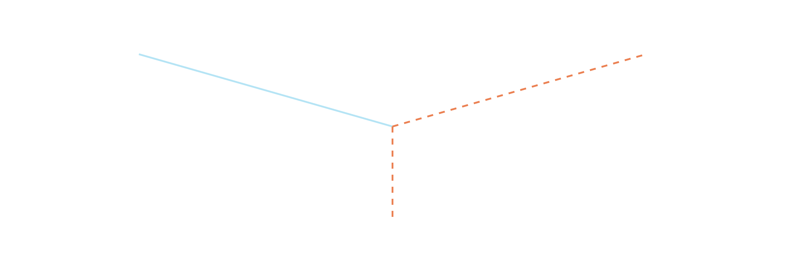
PART THREE · THE REST OF THE ICEBERG
Your app depends on things you don't control.
Payment provider
Another team's system
Your app
A third-party service
Notes:
Modern apps are assembled, not written in isolation. They lean on payment providers, other teams' systems, and outside services that can change or break without warning. A one-line feature can sit finished and blocked because something it depends on isn't ready. You're building one room in a house wired to utilities you don't own.

Slide 16
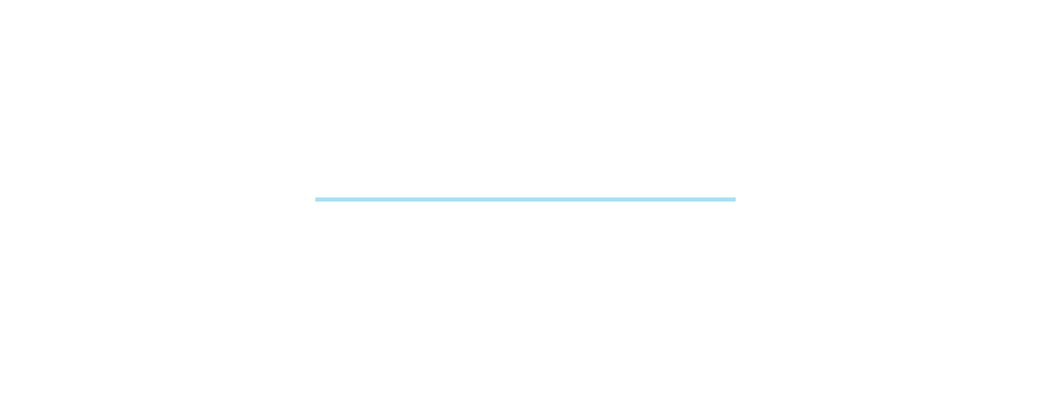
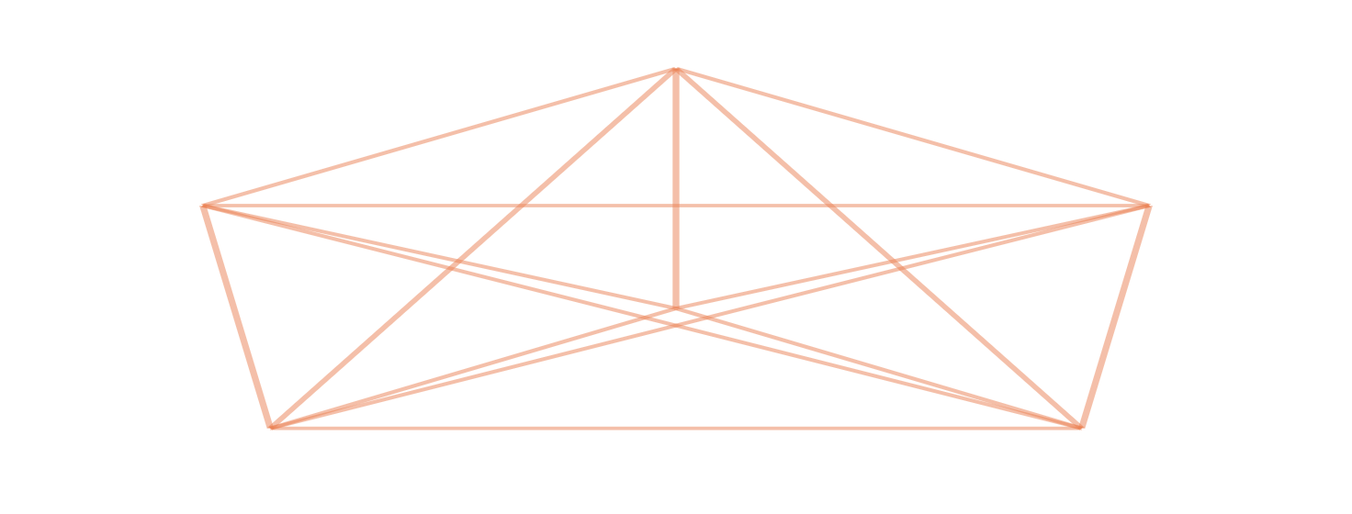
PART THREE · THE REST OF THE ICEBERG
Nine people can't make a baby in one month.
2 PEOPLE · 1 PATH
6 PEOPLE · 15 PATHS
Notes:
The natural fix for 'too slow' is 'add people,' and it often backfires. More people means more communication, more handoffs, more ways to step on each other. The web of connections grows far faster than headcount — sometimes a bigger team is a slower team. This one genuinely surprises people, so let it breathe.

Slide 17
Build
PART THREE · OVER TIME
New devices
New rules
New expectations
Building is a fraction of the lifetime cost.
Fixing old shortcuts
You launch the tip. Maintenance is the mass beneath it.
MAINTAIN
Notes:
Shipping is the beginning, not the end. Software rots as the world moves: new phones, new regulations, new expectations, and the debt from every shortcut taken under deadline. Maintenance isn't optional cleanup — it's the larger, ongoing part of the cost. The thing you launch has to keep standing in a world that won't hold still.

Slide 18
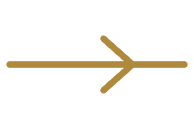
THE TAKEAWAY
So how do you work well with the people who build this?
Notes:
Signal the turn. Everything so far explained the gap. The last few minutes turn it into something they can use tomorrow. This is the part they'll remember, so slow down and make eye contact.

Slide 19



THE TAKEAWAY · THREE HABITS
How to be a great partner.
Ask for ranges.
Bring problems, not solutions.
Treat questions as the work.
A confident single date deserves suspicion.
Let the team find the cheapest path to it.
A pile of questions is progress, not delay.
Notes:
Three concrete habits. First, ask for a range, not a single date — treat a confident single date with suspicion. Second, bring the problem you're trying to solve, not a solution you've already picked, so the team can find the cheapest path. Third, when engineers ask a pile of questions, that's not delay — that's the work getting done in the open. These change the relationship more than any process does.

Slide 20
The most expensive thing you can build is the wrong thing quickly.
Notes:
Say it, then stop talking for a beat. Optionally pair it with the trade-off: fast, cheap, and good is a choice of two, never all three. Thank them, and open it up.

Slide 21
THANK YOU
Questions
Your name · how to reach you
Notes:
Buffer built in. If the room is quiet, seed it: 'The one I get most is, why can't we just add more people — so let's start there.' Have one or two of your own real examples ready to pull the discussion into their world.

